Slide 1
Image Super resolution
CSCI 5922 – Neural Networks and Deep Learning Project
Kaushik Metha

Slide 2
Introduction
Want to Enhance your image quality?
Image super resolution to the rescue
What is image super resolution?

Slide 3
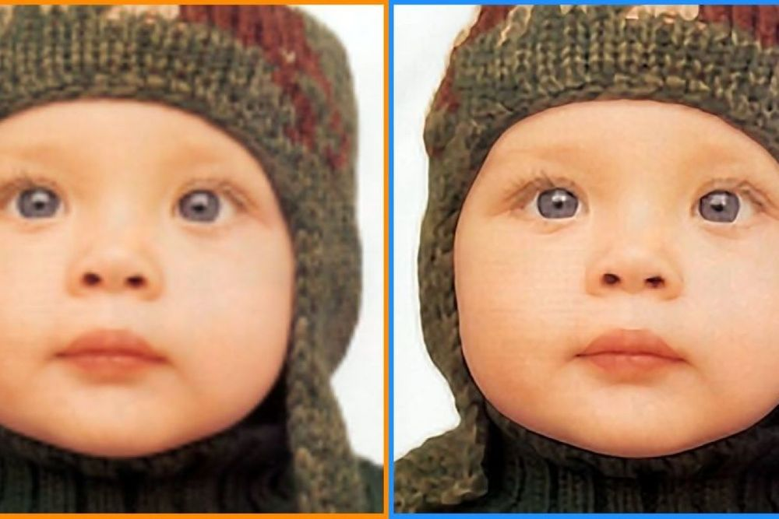
This is super resolution!

Slide 4
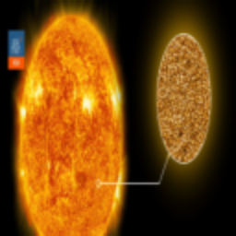

Dataset
Collected from Kaggle (Link)
Images from various domains
685 train and 170 test images (Low-res and high-res pair)
Low resolution image
High resolution image

Slide 5
Data Preprocessing and preparation
Resize to 256 x 256 x 3
Normalize: 0 to 1
split into train – validation – test
Dataset (Link)

Slide 6
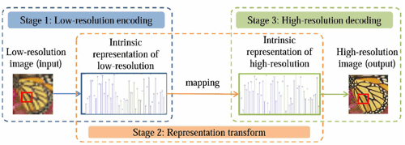
Model architecture
Autoencoder approach
Encoder
Feature extraction
Downsampling
compression
Decoder
Upsampling
Feature reconstruction
Output generation
Skip connections

Slide 7
Results
Parameters:
Epochs: 1000
Batch size: 128
Optimizer: adam
Loss: mean squared error
Metrics: Peak signal-to-noise ratio and structural similarity index
Validation split: 20%

Slide 8
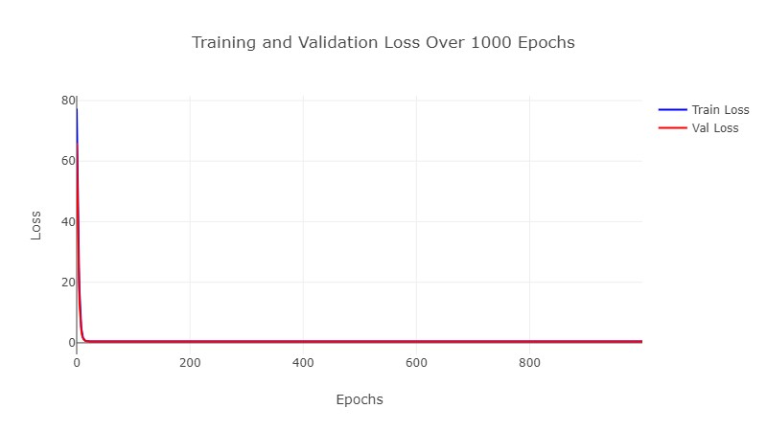
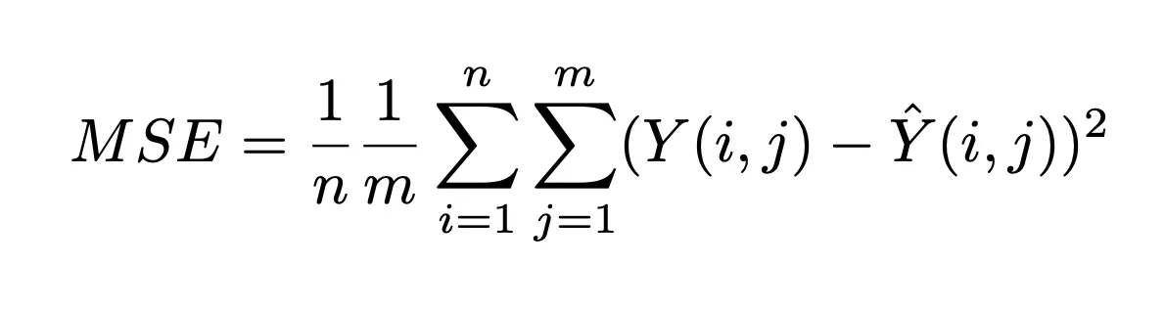
Loss – mean squared error

Slide 9
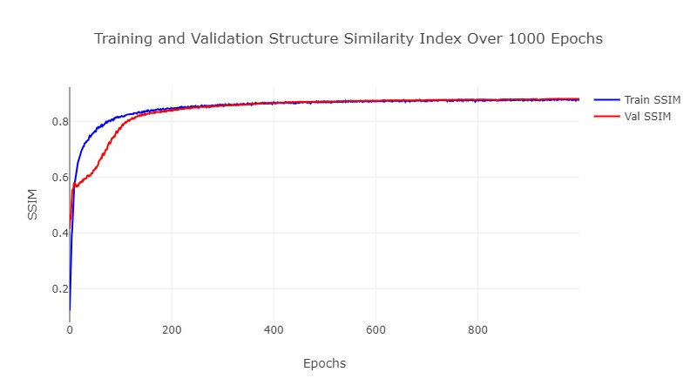
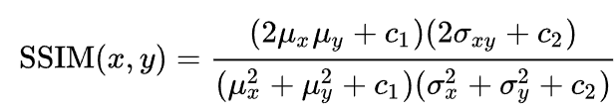
Structural Similarity Index

Slide 10
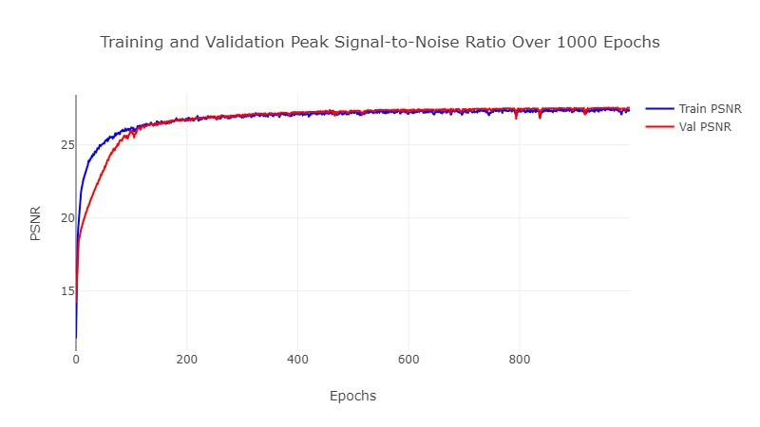

Peak signal-to-noise ratio

Slide 11
Model Performance
 | MSE | PSNR | SSIM
Training | 0.4589 | 27.3409dB | 0.8784
Validation | 0.4593 | 27.5442dB | 0.8816
Testing | 0.4594 | 27.3148dB | 0.8767

Slide 12
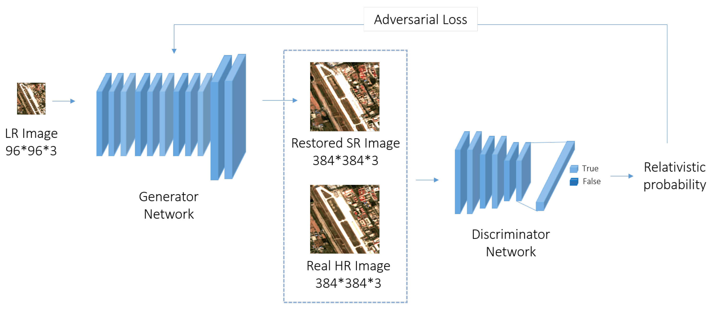
Conclusion and future work
Decent model performance
Why psnr and ssim over accuracy?
Using gans
Incorporating different dimensions

